Slide 1
“YUVA GUIDE” – Ai career agent
CAPSTONE PROJECT
Presented By:
1. Devesh Sain-JECRC Foundation-AI&DS

Slide 2
OUTLINE
Problem Statement
Proposed System/Solution
System Development Approach
Result (Output Image)
Conclusion
Future Scope
References

Slide 3
Problem Statement
Youth in rural areas often lack access to structured career guidance due to limited exposure, absence of professional counselors, and poor awareness of skill development opportunities. Many students are unaware of job-oriented courses, government schemes, or online training platforms that could help them build a career aligned with their interests.
There is a strong need for a smart, localized, and accessible solution that can provide personalized career guidance to rural youth based on real-time, trusted information.

Slide 4
Proposed Solution
Yuva Guide is an AI-powered career guidance agent tailored for rural youth.
Built using IBM Cloud Lite Services and IBM Granite AI models
It offers:-
Personalized career advice based on user inputs (interests, skills, education level)
Recommendations for job-oriented courses, government schemes, and online training platforms
Multilingual support(Hindi/English) to ensure accessibility across diverse regions
The AI agent interacts through a chat interface (text or voice), making it user-friendly even for individuals with limited digital skills.
It pulls real-time, verified data from trusted sources and government websites to provide reliable and localized guidance.
Lightweight, cloud-hosted, and scalable, making it suitable for wide adoption in low-resource rural settings.

Slide 5
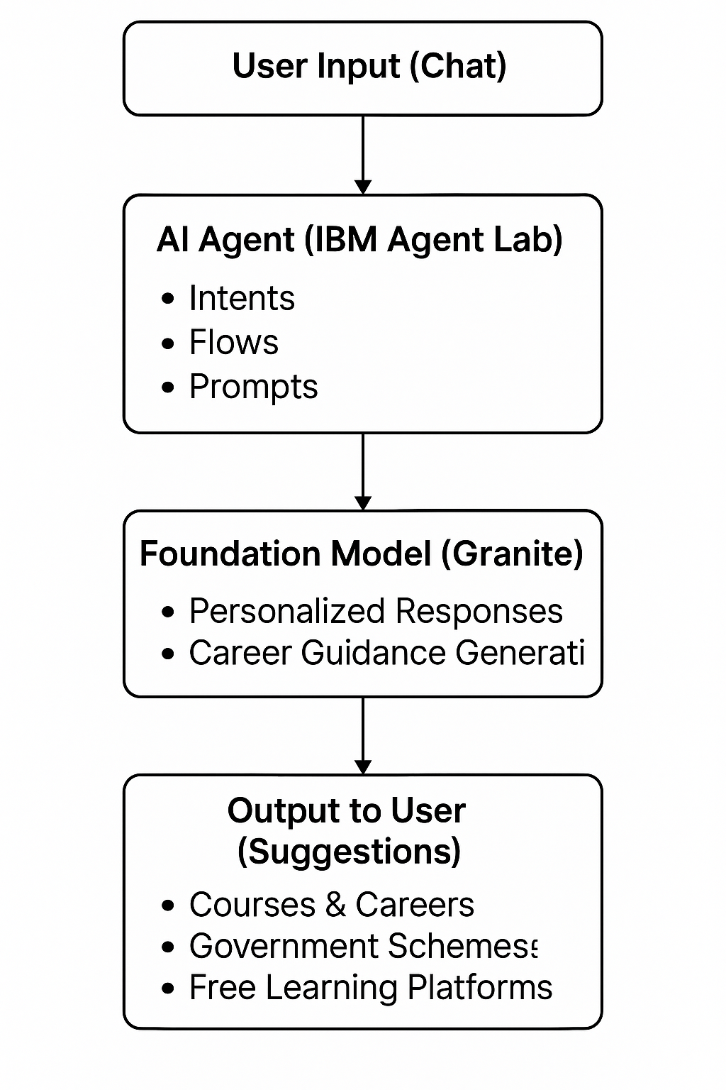
System Approach
1. User Interaction Layer
Users interact through a chat interface (web or mobile).
Example query:
“Which course is best after 10th for government jobs?”
2. AI Agent Built Using IBM Agent Lab
The core logic resides in a custom AI agent, developed using IBM Agent Lab.
The agent uses intents, flows, and prompts to simulate a smart career counselor.
3. Foundation Model Integration (IBM Granite)
The agent uses IBM Granite foundation models for:
Personalized, human-like responses
Career suggestions based on user goals
Information about online courses or schemes
4. Predefined Domain Knowledge (Internal to Prompts)
Information is embedded in prompts and flows, such as:
Job-oriented fields
Government schemes for rural students
Free online learning platforms
Career planning guidance

Slide 6
System Approach
5. Output Layer
The agent provides:
Career suggestions
Skill-building advice
Awareness of schemes and online resources
Responses are localized, simple, and student-friendly.
IBM Services used:-
IBM Agent Lab Built and deployed an AI agent to assist rural youth with career counseling through natural language interaction.
Granite Foundation Models Leveraged IBM's pre-trained large language models to provide accurate and personalized career suggestions.
Watsonx Runtime Service Enabled real-time processing and dynamic responses from the AI agent.
Cloud Object Storage Stored training content, government scheme data, and career-related resources securely.
Identity and Access Management (IAM) Controlled access, ensuring data security and user authentication.

Slide 7
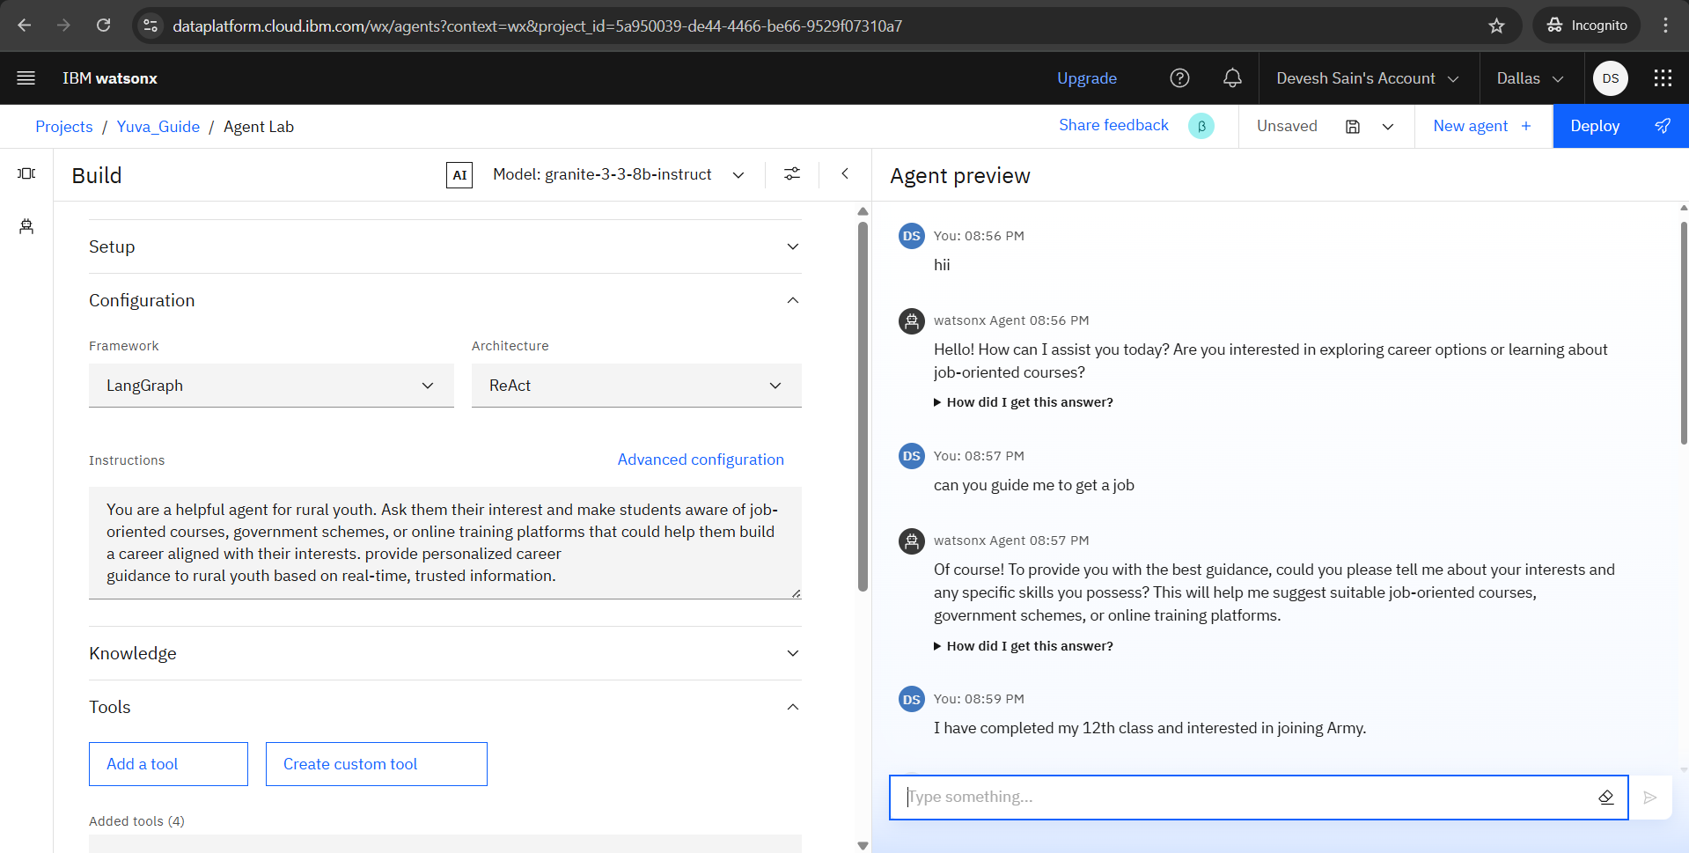
Result
“Agent asking student(user) about his relevant skills & interests”

Slide 8
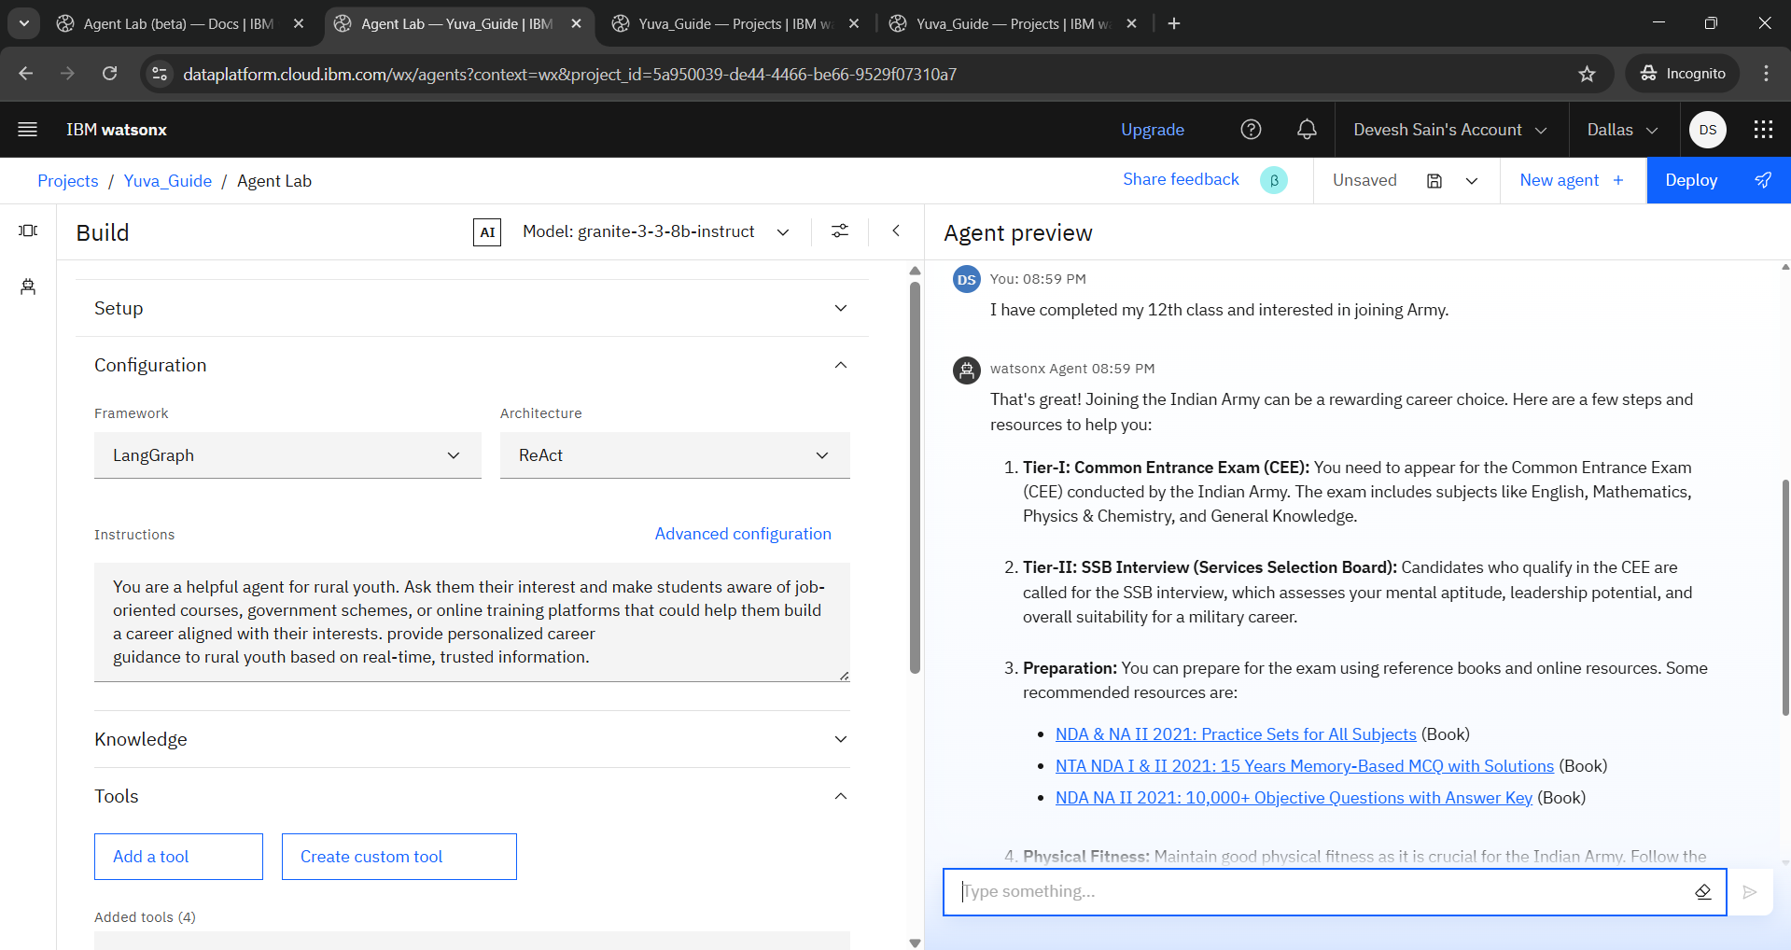
Result
“Agent guiding the student based on the query”

Slide 9
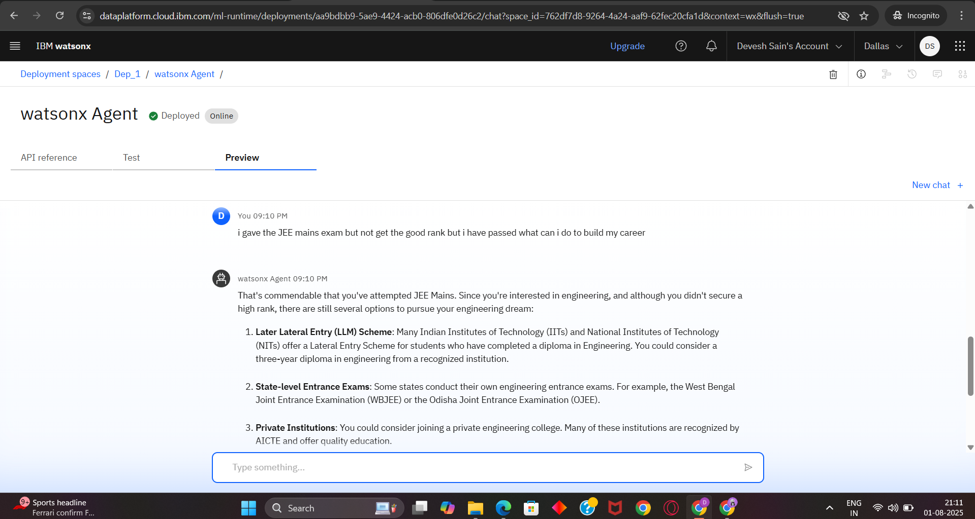
Result
“The AI agent encourages the student and offers multiple career paths without disappointment.”

Slide 10
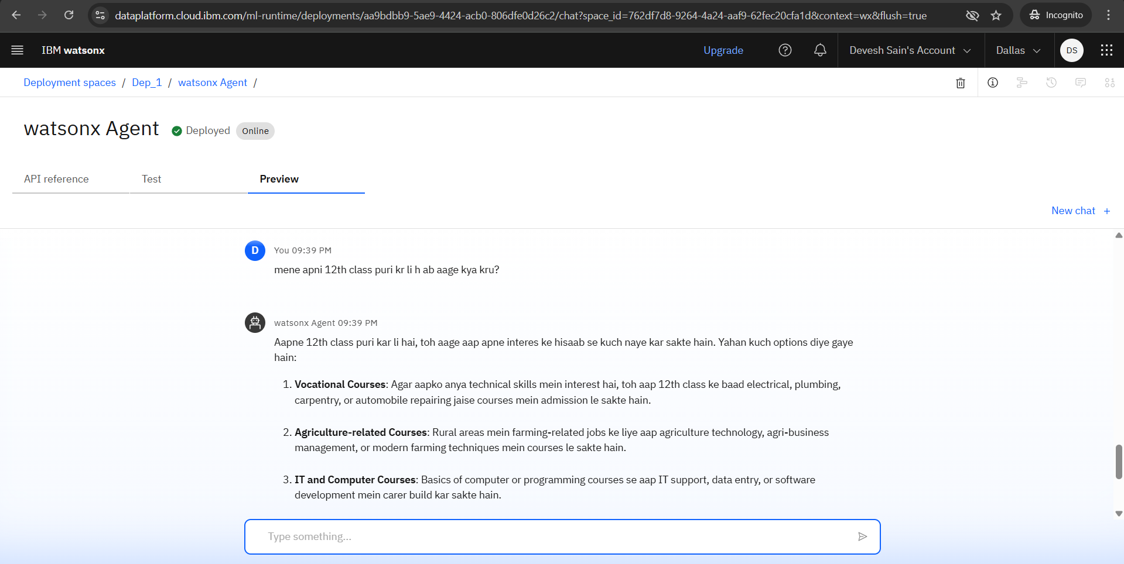
Result
“Multilingual support by Agent”

Slide 11
Conclusion
Yuva Guide successfully addresses the gap in career guidance for rural youth by offering a smart, scalable, and accessible AI agent.
Built with IBM Cloud Lite, Granite model, and IBM Runtime services, it provides:
Personalized career recommendations
Access to real-time information on jobs, courses, and schemes
Multilingual and user-friendly interface tailored for rural India
It empowers youth to make informed career decisions, reduces underemployment, and bridges the information divide.

Slide 12
Future scope
With further development, Yuva Guide can scale across states, integrate voice features, and become a National platform for AI-driven career support.
Voice Interaction in Regional Languages → Add voice-based input/output to improve accessibility for users with low literacy.
Integration with Job Portals → Real-time job listings and internship opportunities based on user profiles.
Geo-based Recommendations → Suggest nearby training centers, offline courses, or government programs.
WhatsApp or SMS Integration → Use existing communication platforms for wider reach.
AI Feedback Loop → Continuously improve recommendations based on user feedback and outcome tracking.

Slide 13
References
IBM Watsonx.ai Documentation Accessed for understanding Agent Lab features, model integration, and deployment process. https://www.ibm.com/docs/en/watsonx
Demo on Agentic AI using IBM Cloud (PDF Guide) Provided by Edunet Foundation; used as a step-by-step reference for project setup and agent building.
IBM Granite Foundation Model Overview For understanding the capabilities of Granite LLMs in generating personalized responses. https://www.ibm.com/watsonx/models/granite

Slide 14
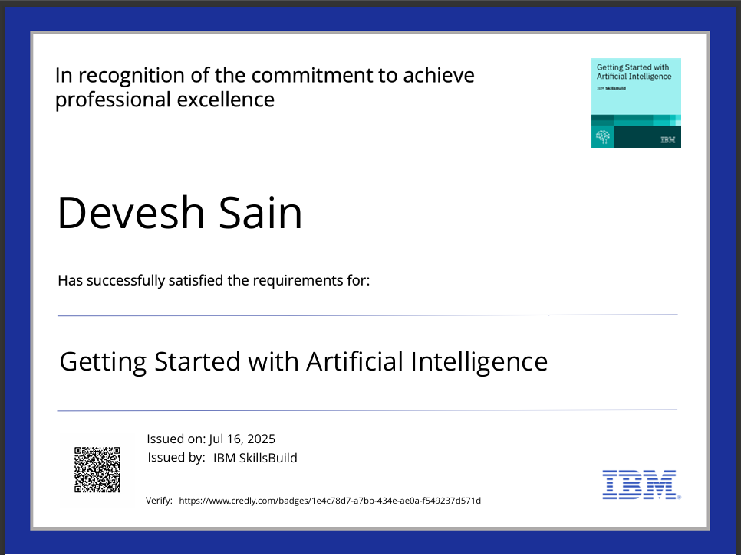
IBM Certifications

Slide 15
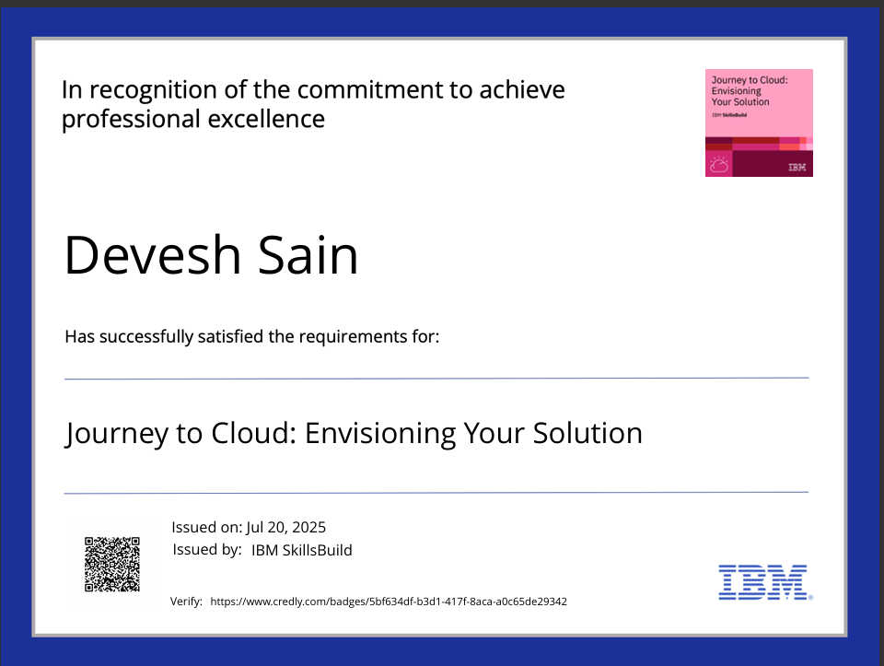
IBM Certifications

Slide 16
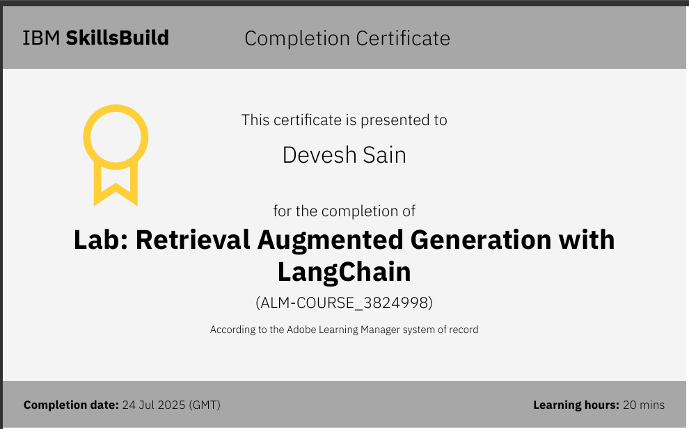
IBM Certifications

Slide 17
THANK YOU

